Slide 1

TransBorder Freight Data Analysis
By Andrew Kojo Mensah-Onumah

Slide 2
Overview
The United States, Canada, and Mexico — North America's most industrialized nations — conduct significant trade annually.
This analysis explores the USA’s trade activity (exports and imports) with Canada and Mexico between January 2020 and September 2024, focusing on freight characteristics, product types, transport channels, and trade value.

Slide 3
Key insights: USA Exports
Canada is the top export destination, with an average of 6% more exports compared to Mexico across the years.
Texas consistently leads as the top exporting state to both countries.
The peak export month to Canada was June 2022, while Mexico’s highest import from the US occurred in October 2023 and August 2024.
Trucks dominate export logistics, highlighting the critical role of truck drivers in cross-border trade.
Ontario (Canada) and Chihuahua (Mexico) receive the largest volume of goods.
Exports to Mexico are freight-charge free, likely due to bilateral trade agreements (e.g., USMCA that took effect in 2020).

Slide 4
Key insights: USA Exports
All Canadian-bound exports are containerized, regardless of transport mode, while over 80% of exports to Mexico are not.
The US exports both domestically produced and foreign-made goods.
Top export categories include:
Minerals: Peak revenue of $32M (Canada) and $61M (Mexico).
Machinery & mechanical appliances: Consistently the most exported products.

Slide 5
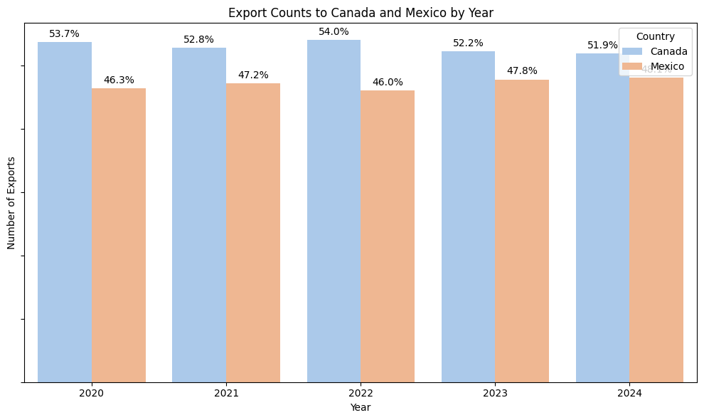

Slide 6
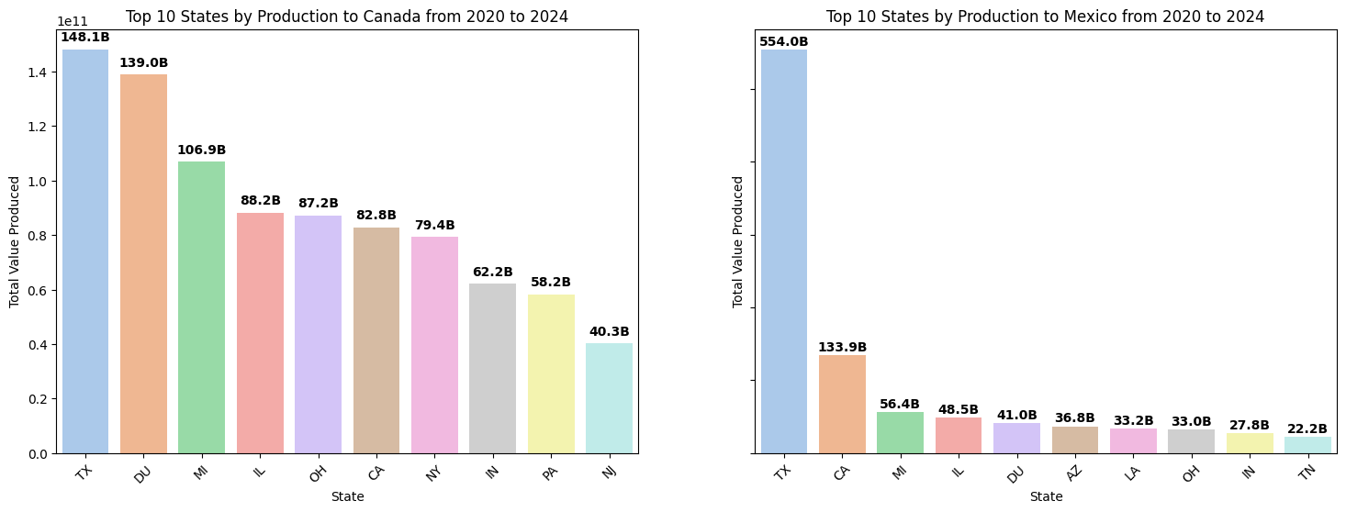

Slide 7
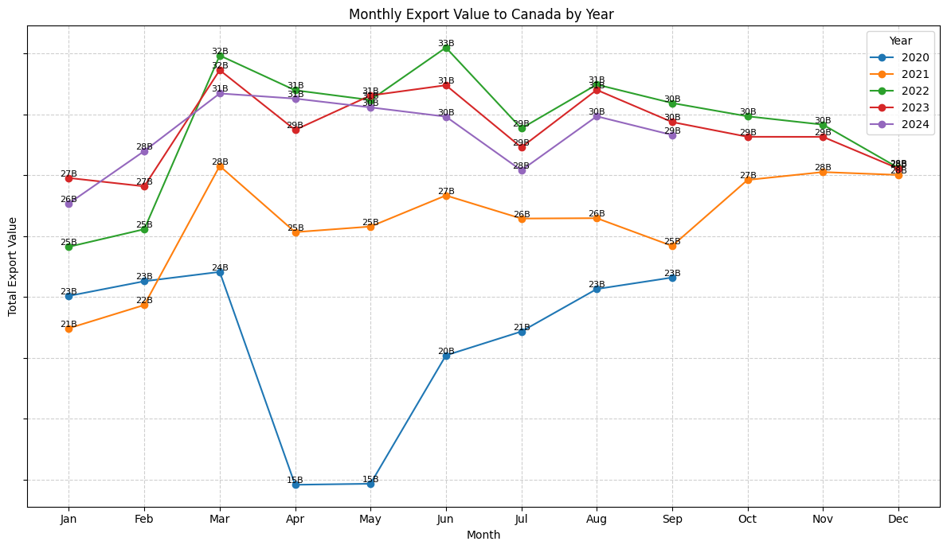

Slide 8
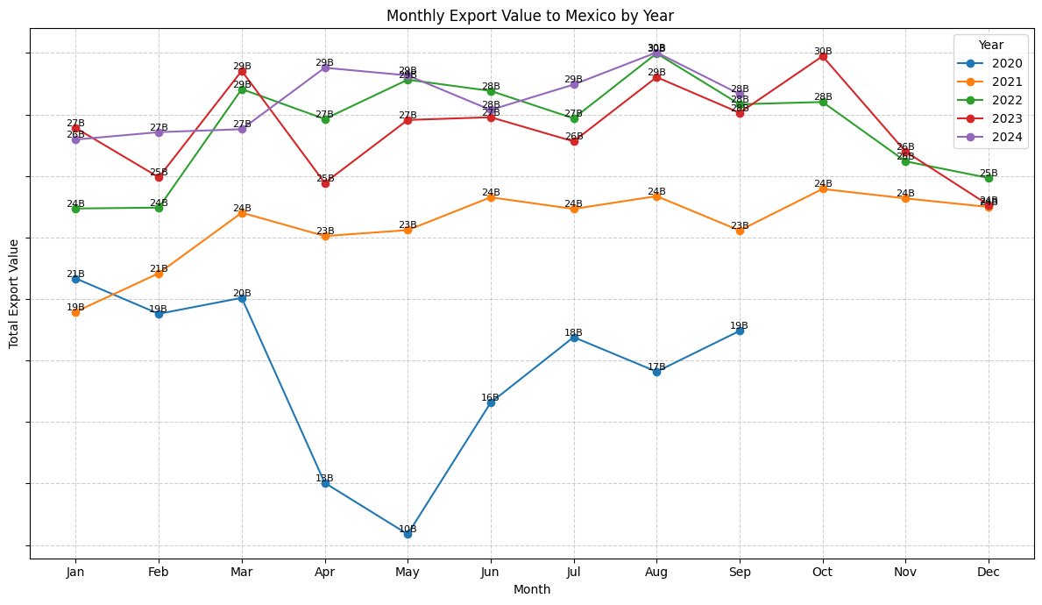

Slide 9
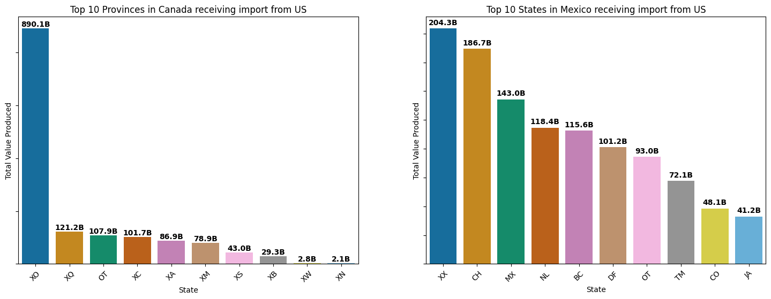

Slide 10
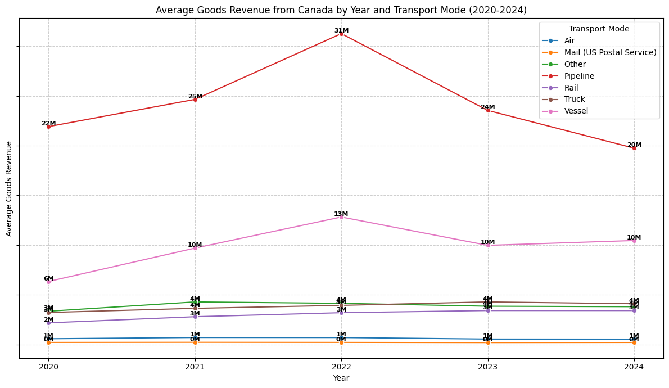

Slide 11
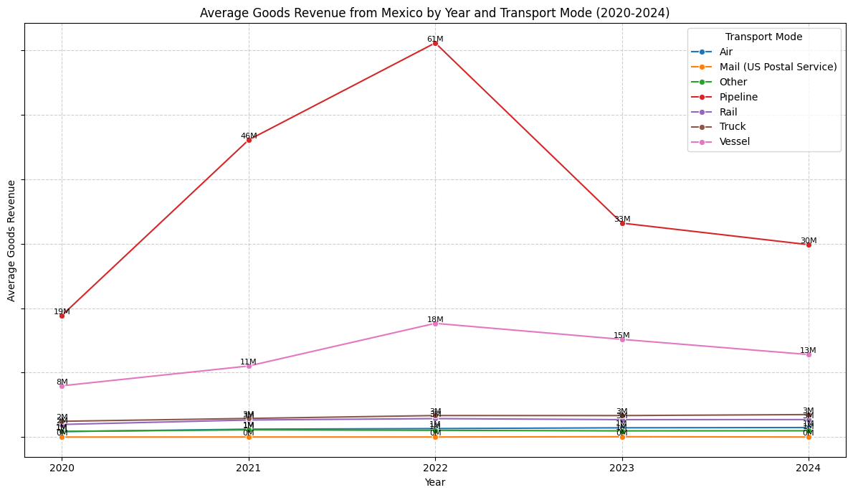

Slide 12
Key Insights: USA Imports
The US imported more goods from Canada than Mexico in volume (approx. 80% from Canada vs. 20% from Mexico).
However, Mexico’s imports have higher total value, suggesting they ship more high-value goods.
Freight charges for imports from Mexico are lower than those from Canada.
Illinois and Texas are the top US destinations for Canadian and Mexican imports respectively.
Canada uses truck, rail, and air as major freight modes; Mexico relies heavily on trucks, though its modes are more diverse overall.
Ontario (Canada) is the largest source of Canadian imports.
Imports from both countries are rarely containerized.
Top import categories include: Heavy machinery, Electrical appliances & Minerals

Slide 13
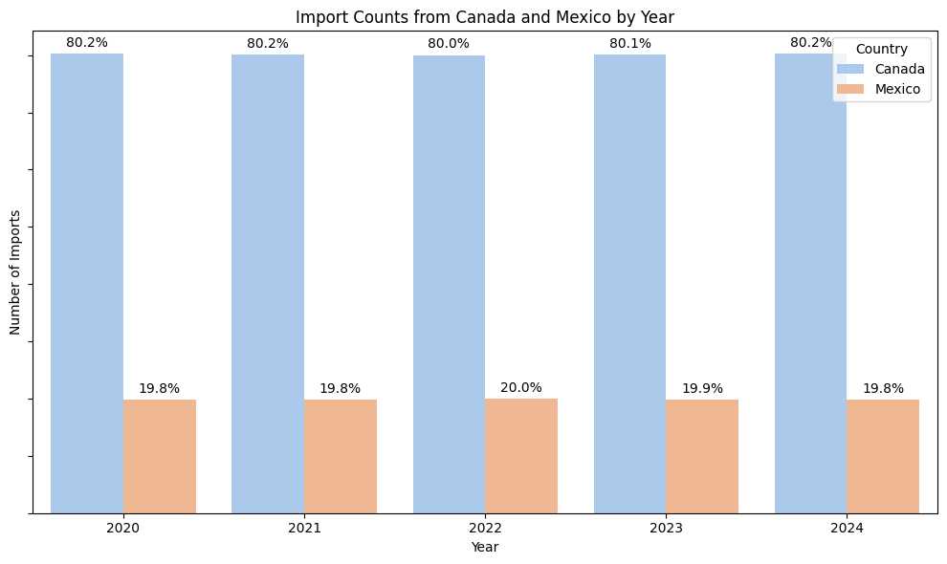

Slide 14
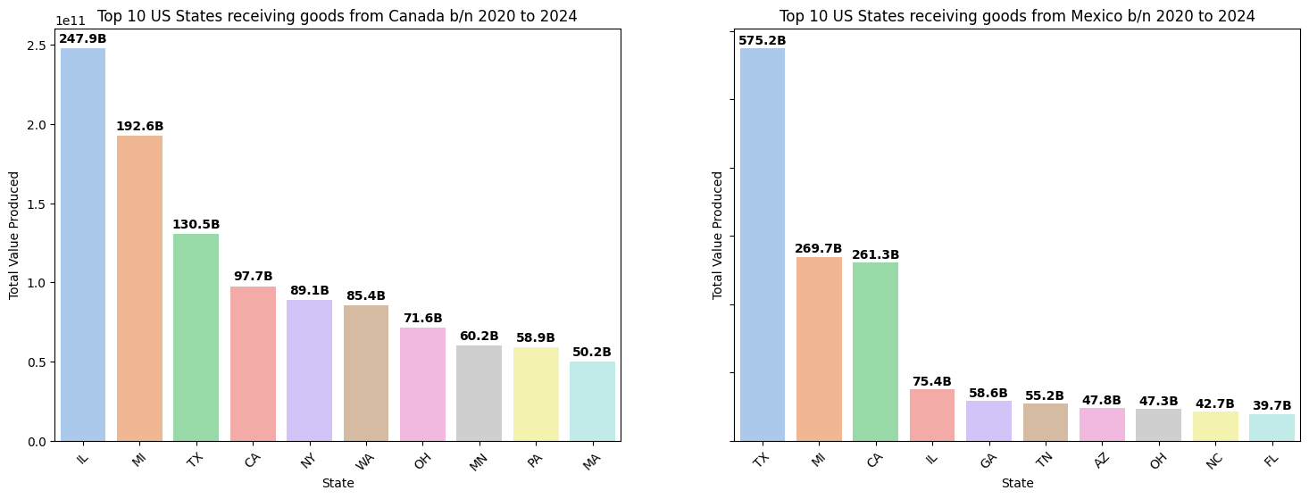

Slide 15
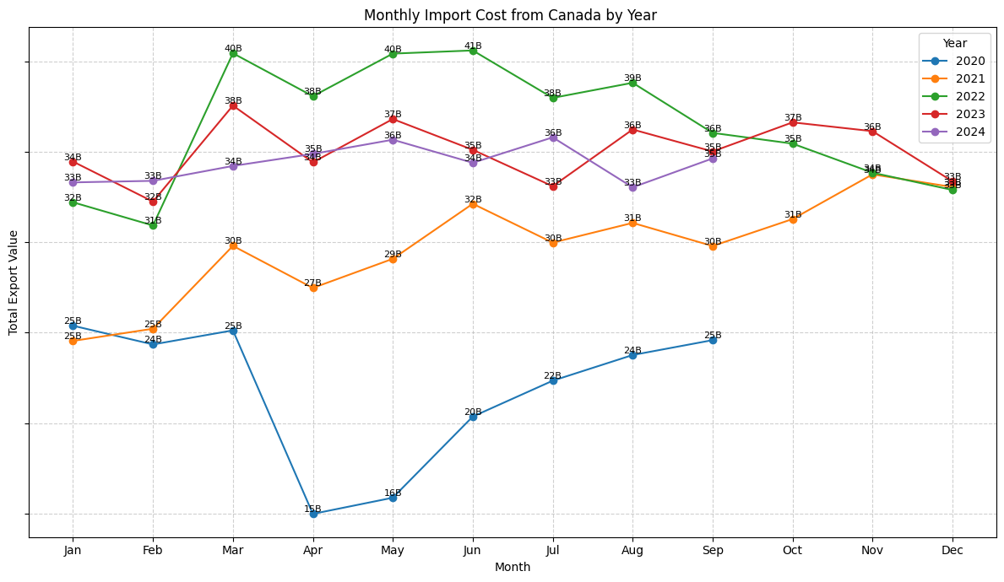

Slide 16
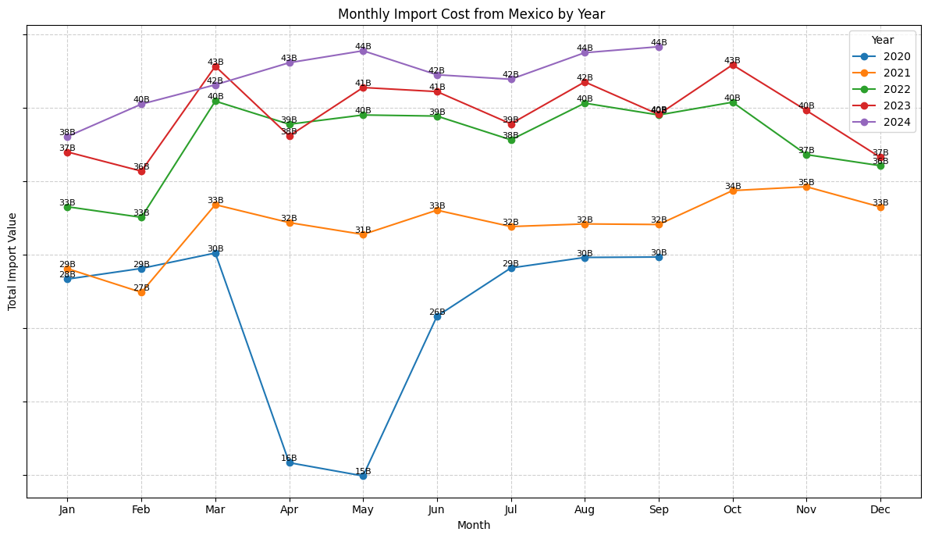

Slide 17
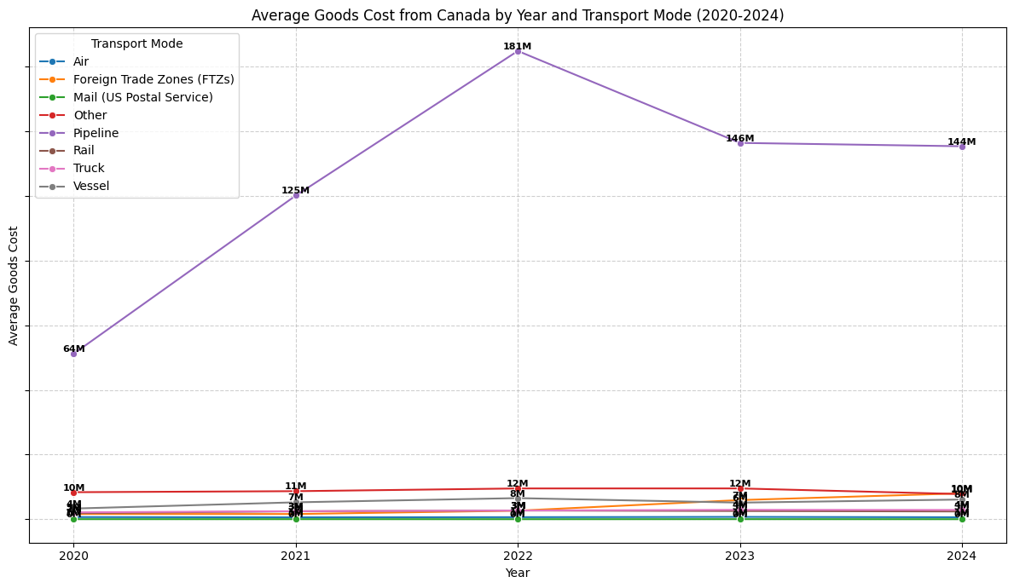

Slide 18
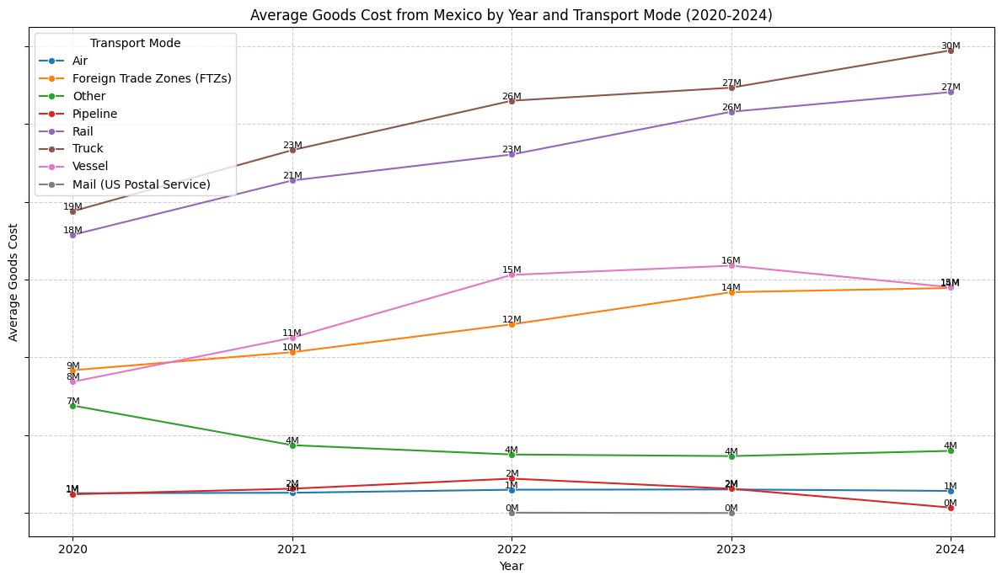

Slide 19
Recommendations
Improve road and border-crossing capacity to support dominant truck-based trade routes.
Explore freight-charge incentives with Canada; optimize cost advantages in Mexico trade.
Promote containerization to improve security, efficiency, and customs processing.
Prioritize high-margin imports (e.g., electronics) from Mexico over bulk goods.
Align logistics and staffing with peak export months (e.g., June, August, October).

